Slide 1
DESCRIBE AZURE GOVERNANCE METHODOLOGIES

Slide 2
Executive summary
As your cloud presence grows, you’ll likely end up with a large number of Azure resources that span many different Azure services. Unless you have some control over how those resources are created and managed, costs can spiral out of control. In addition to cost control, you may have other restrictions you’d like in place as well, such as which regions certain resources should be created in, or how certain resources are tagged, and so on.
Fortunately, Azure Policy can ensure your requirements and policies are adhered to.
Source: …

Slide 3
Agenda
Azure Policy
Role-based access control
Locks
Azure Advisor

Slide 4
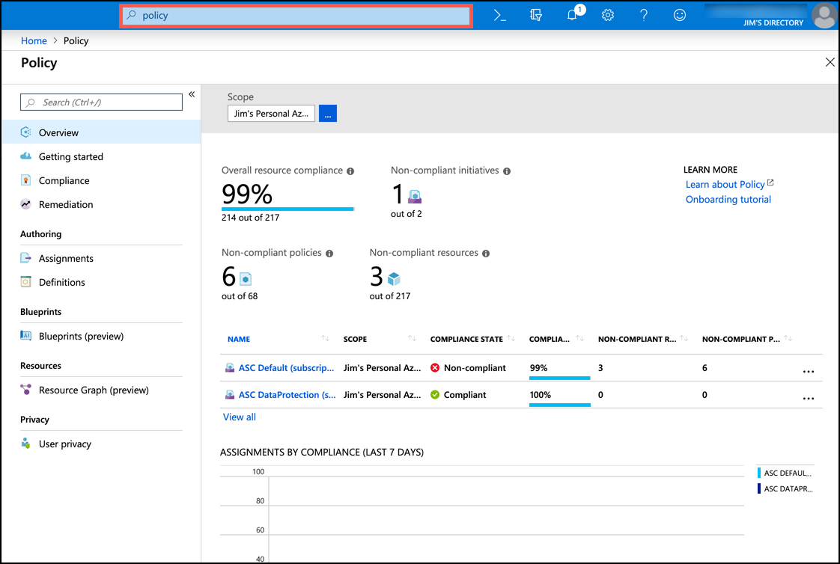
Azure Policy
Azure Policy allows you to define rules that are applied when Azure resources are created and managed.
To access Azure Policy, type policy in the search box in the Azure portal and click on Policy. Alternatively, you can click on All Services and search for “policy” in the list.
For example, you can create a policy that specifies that only a certain size VM can be created and that the VMs must be created in the South Central US region

Slide 5
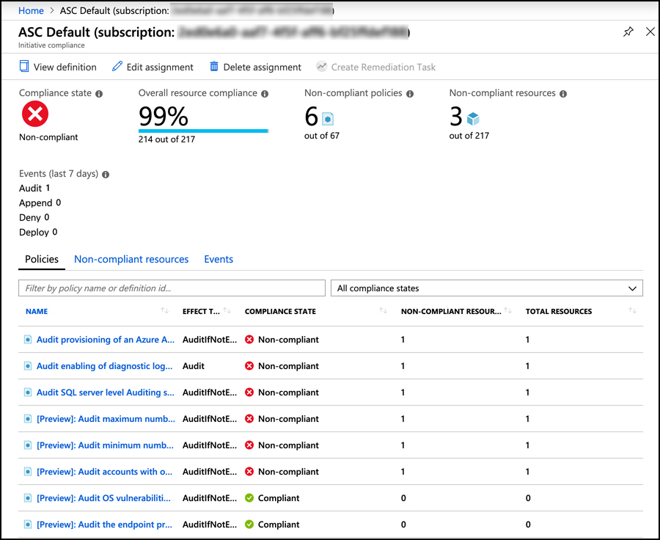
Azure Policy
By clicking on the non-compliant item, you can see the full details of what is and isn’t within policy

Slide 6
Azure Policy
By clicking on the non-compliant item, you can see the full details of what is and isn’t within policy.
Notice that the title of this item is ASC Default followed by a subscription ID. ASC Default is actually a collection of multiple policies that are defined by Azure Security Center. Azure Policy makes it easy to impose a full suite of policies by combining them into a group called an initiative. By defining an initiative, you can easily define complex rules that ensure governance of your company’s policies.

Slide 7
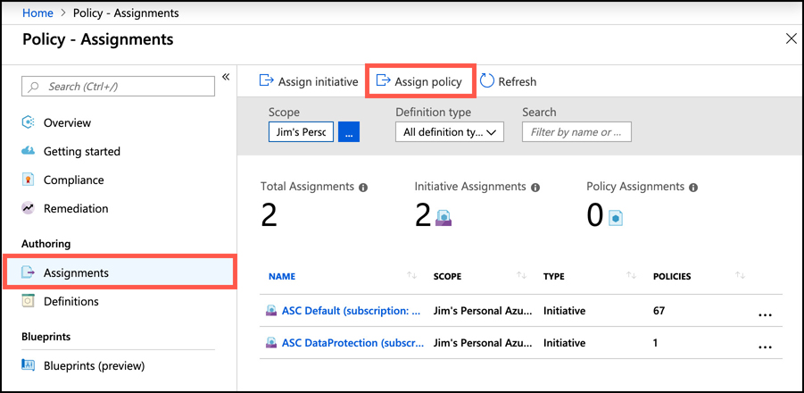
Azure Policy
You can assign a new policy either by selecting a policy from a list of included policies, or by creating your own policy. To assign a policy from the list of included policies, click on Assignments and then click Assign Policy

Slide 8
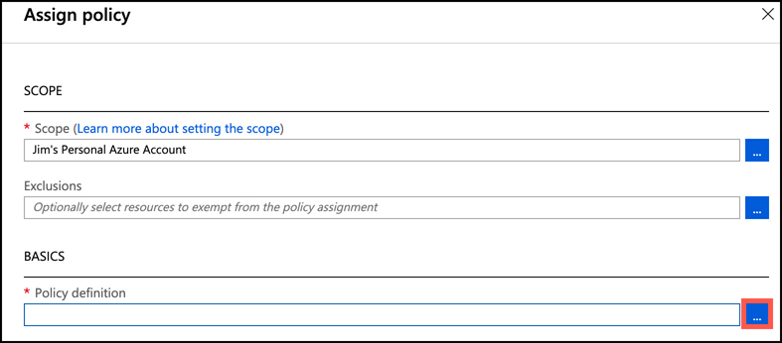
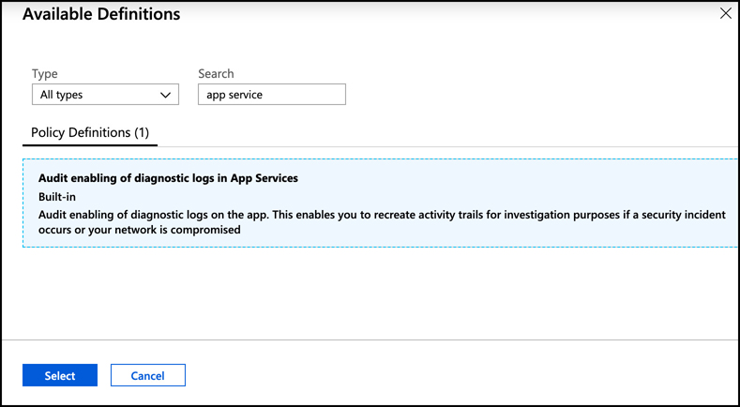
Azure Policy
Click the ellipses next to Policy Definition to select a policy.
In this case, you apply a policy that will ensure that any App Service app that gets created has diagnostic logging enabled. You can do that by entering app service in the search box, and selecting the built-in policy that applies to that policy

Slide 9
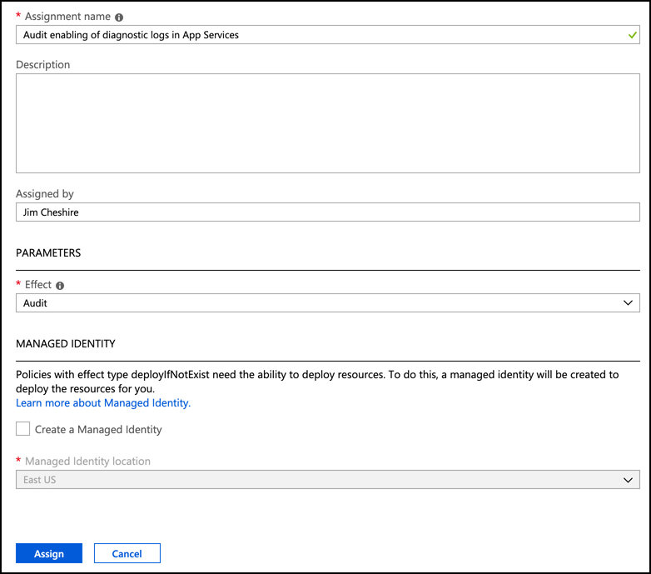
Azure Policy
The effect of this particular policy is Audit, meaning that if the policy isn’t in compliance, a warning will appear in the portal, but it will still allow the resource to be created.

Slide 10
Azure Policy
There are 6 different effects supported in Azure policy. Not all effects, however, are available for built-in policies. The effects are:
Append Adds additional properties to a resource. It can be used to add a tag with a specific value to resources.
Audit Logs a warning if the policy is not complied with.
AuditIfNotExists Allows you to specify an additional resource type that must exist along with the resource being created or updated. If that resource type does not exist, a warning is logged.
Deny Denies the create or update operation.
DeployIfNotExists Allows you to specify an additional resource type that you want deployed, along with the resource being created or updated. If that resource type is not included, it is automatically deployed.
Disabled The policy is not in effect.
Notes:
In addition to using the built-in policies, you can also define your own policies by creating a custom policy definition. Custom policy definitions are ARM templates that define the policy. For more information on creating a custom policy definition, see: https://docs.microsoft.com/en-us/azure/governance/policy/tutorials/create-custom-policy-definition.

Slide 11
Agenda
Azure Policy
Role-based access control
Locks
Azure Advisor

Slide 12
Role-based access control
Role-based access control (RBAC) is a generic term that refers to the concept of authorizing users to a system based on defined roles to which the user belongs. Azure implements RBAC across all Azure resources so that you can control how users and applications can interact with your Azure resources.
4 elements to RBAC.
Security principal The security principal represents an identity. It can be a user, a group, an application (which is called a service principal), or a special AAD entity called a managed identity. A managed identity is how you authorize another Azure service to access your Azure resource.
Role A role (sometimes called a role definition) is what defines how the security principal can interact with an Azure resource. For example a role might define that a security principal can read the properties of a resource but cannot create new resources or delete existing resources.
Scope The scope defines the level at which the role is applied, and it controls how much control the security principal has. For example, if the scope is to a resource group, the role defines activities that can be performed on all matching resources in the resource group.
Role assignments Roles are assigned to a security principal at a particular scope, and that’s what ultimately defines the level of access for the security principal.

Slide 13
Role-based access control
RBAC includes many built-in roles. Three of these built-in roles apply to all Azure resources.
Owner Members of this role have full access to the resources.
Contributor Members of this role can create resources and manage resources, but they cannot delegate that right to anyone else.
Reader Members of this role can see Azure resources, but they cannot create, delete, or manage those resources.
RBAC roles can be scoped to the management group, subscription, resource group, or resource level.

Slide 14
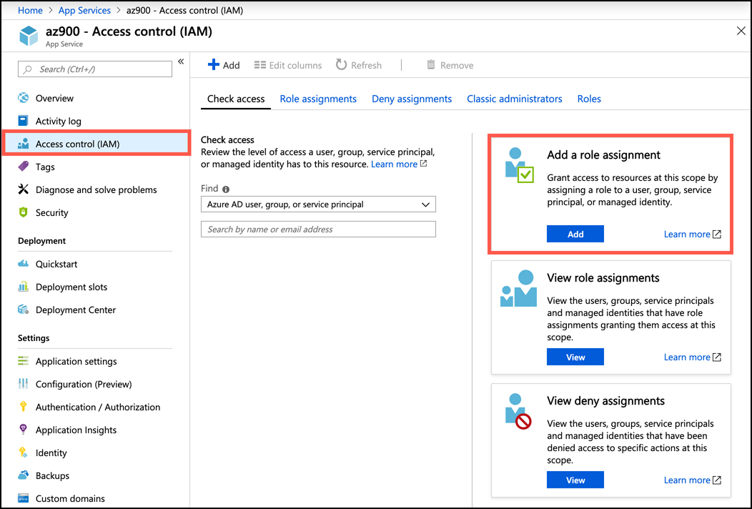
Role-based access control
To give someone access to a resource using RBAC, open the resource you want to give access to in the Azure portal. Click on Access Control (IAM) in the portal to configure RBAC.
RBAC is being configured for a web app hosted in Azure App Service. Clicking on Add in the Add a Role Assignment box allows you to add a role.

Slide 15
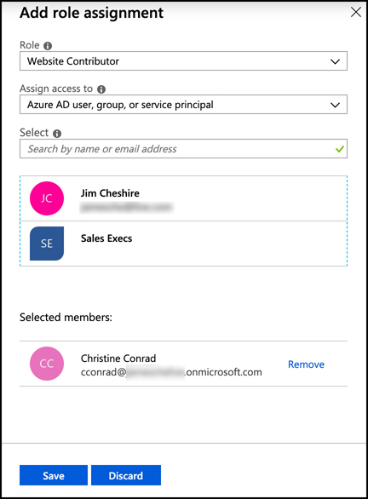
Role-based access control
After clicking Add, choose the role you want to assign. The list of roles will differ depending on what type of resource this is.
Choose who or what you want to assign the role to, and then click on Save.
This shows a list of users in the AAD, because the Assign Access To dropdown is set to AAD objects. You can see a list of other types of objects by selecting a different type.

Slide 16
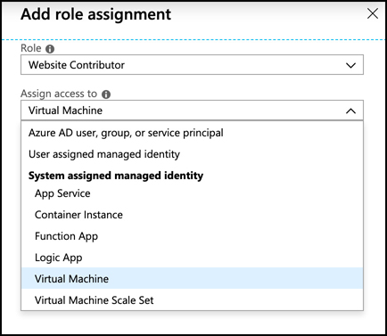
Role-based access control
In this figure, we are selecting a built-in managed identity type that will add Azure VMs to the Website Contributor role for this web app.
It’s important to understand that role assignments are additive. Your RBAC abilities at any particular scope are the result of all role assignment up to that level.

Slide 17
Role-based access control
RBAC is enforced by Azure Resource Manager (ARM). When you attempt to interact with an Azure resource, whether in the Azure portal or by using a command line tool, you are authenticated by ARM and a token is generated for you. That token is a representation of your identity and all of your role assignments, and it’s included with all operations you perform on the resource. ARM is able to determine if the action you are performing is allowed by the roles to which you are assigned. If it is, the call succeeds. If not, you are denied access.

Slide 18
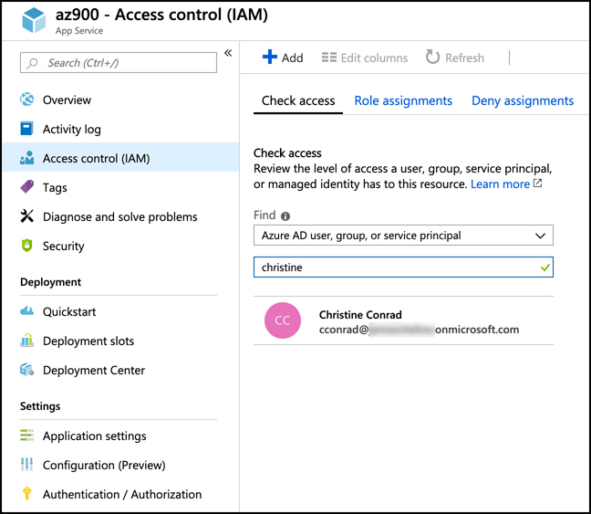
Role-based access control
You can ensure that someone has the rights you desire by checking access in the Azure portal. Open the resource and click on Access Control (IAM). Click the Check Access tab and search for the user or resource you’ve granted access to.

Slide 19
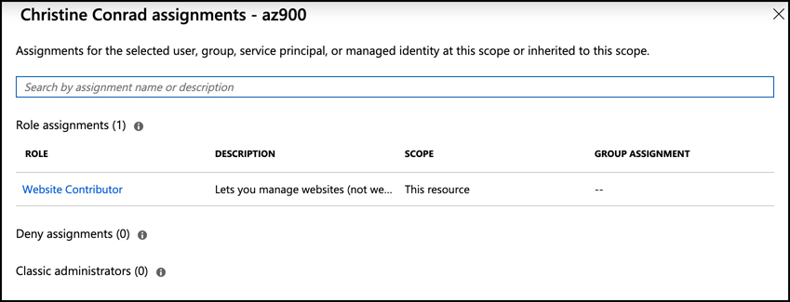
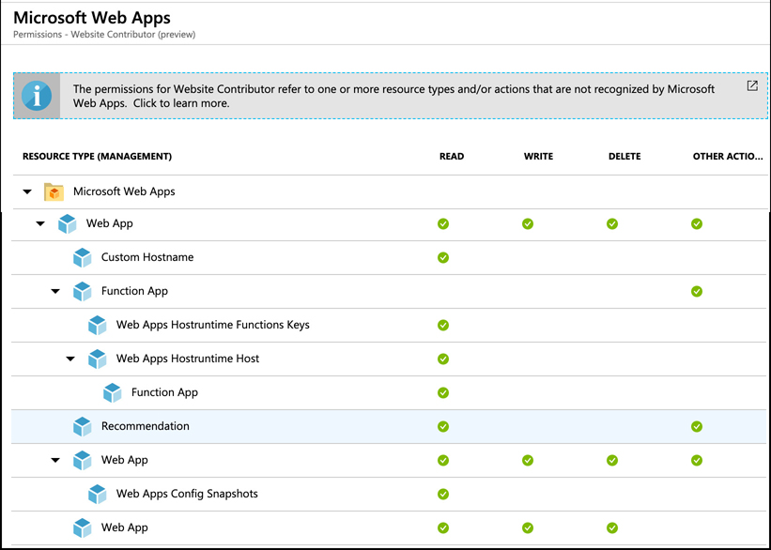
Role-based access control
Click on the user or other object and the access to the resource will be displayed.
For a greater level of detail on what exact operations are and aren’t allowed, click on the role that’s displayed. This will allow you to see a detailed list of operations and the combination of read, write, delete, and other actions that a security principal can perform

Slide 20
Agenda
Azure Policy
Role-based access control
Locks
Azure Advisor

Slide 21
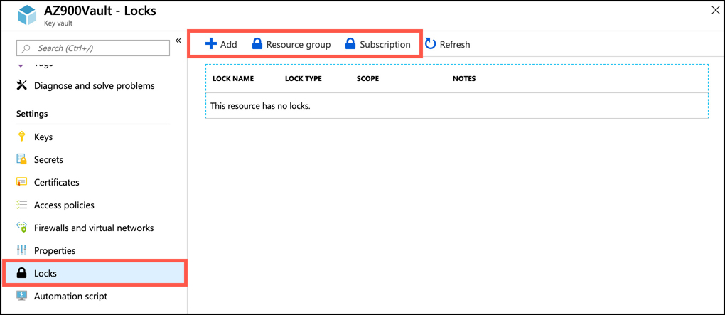
Locks
RBAC is a great way to control access to an Azure resource, but in cases where you just want to prevent changes to a resource, or prevent that resource from being deleted, locks are a simpler solution. Unlike RBAC, locks apply to everyone with access to the resource.
In order to create a lock, you must either be in the Owner or the User Access Administrator role in RBAC. Alternatively, an administrator can create a custom role that grants the right to create a lock.
Locks can be applied at the resource level, the resource group level, or at the subscription level. To apply a lock to a resource, open the resource in the Azure portal and click Locks in the Settings section.

Slide 22
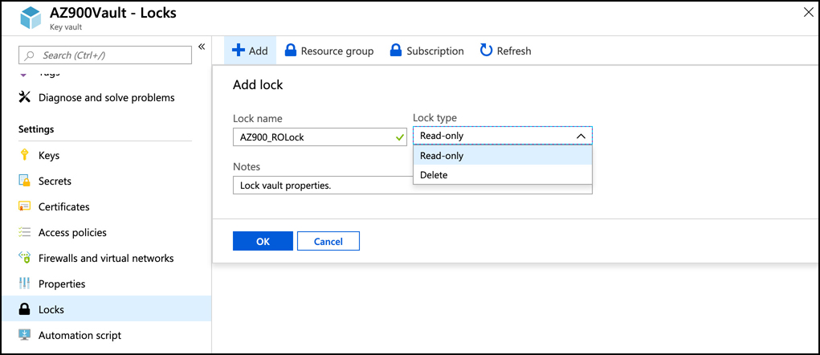
Locks
To add a lock to the resource, click Add. (You can also review and add Locks to the resource group by clicking on Resource Group, or to the subscription by clicking on Subscription.) Provide a name for the lock, set the lock type, and add an optional note.
A read-only lock is the most restrictive lock. It prevents changing properties of the resource or deleting the resource.
A delete lock prevents the resource from being deleted, but properties can still be changed. The result of a read-only lock is often unpredictable, because of the way that locks are handled by Azure.

Slide 23
Locks
Locks only apply to operations that are handled by ARM, and some operations specific to a resource are handled internally by the resource instead of being handled by ARM.
If a lock is applied to a resource group, all resources in that resource group inherit the lock. Similarly, if a lock is applied at the subscription level, all resources in the subscription inherit the lock. It is possible to nest locks, and in such situations, the most restrictive lock is the effective lock.
Locks are also inherited by newly-created resources. If you apply a delete lock to a resource group, and add a new resource to the resource group at a later time, the new resource will automatically inherit the delete lock.

Slide 24
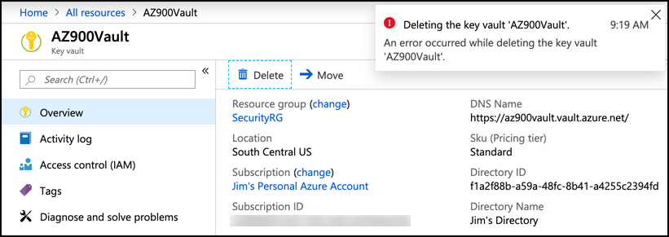
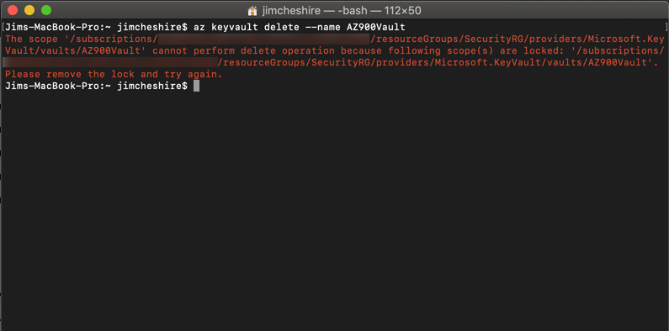
Locks
When an operation is attempted in the portal and denied because of a lock, an error will display. Notice that there isn’t any information about why the operation failed, so unless you know that a lock is applied on a resource, you might find this failure confusing.
Attempting to delete the Key Vault from the Azure command-line interface (CLI), however, clearly shows that the delete failed because of a lock

Slide 25
Agenda
Azure Policy
Role-based access control
Locks
Azure Advisor

Slide 26
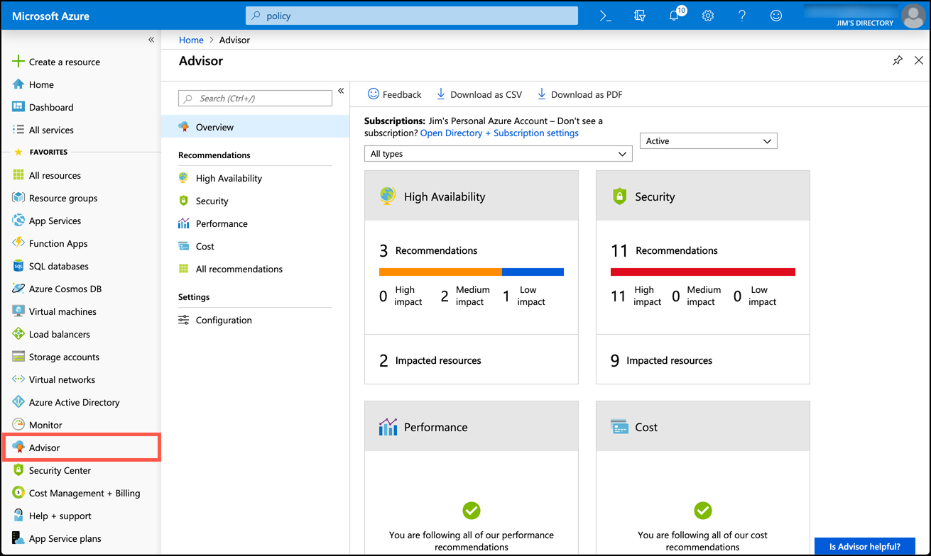
Azure Advisor
Azure Advisor helps you ensure high-availability and performance, control costs, and to secure your Azure resources. Security assistance in Azure Advisor is fed directly from Azure Security Center, but Azure Advisor provides a single view of all recommendations, including the ability to take action on recommendation directly in the Azure Advisor blade.
To access Azure Advisor, click Advisor in the menu in the Azure portal

Slide 27
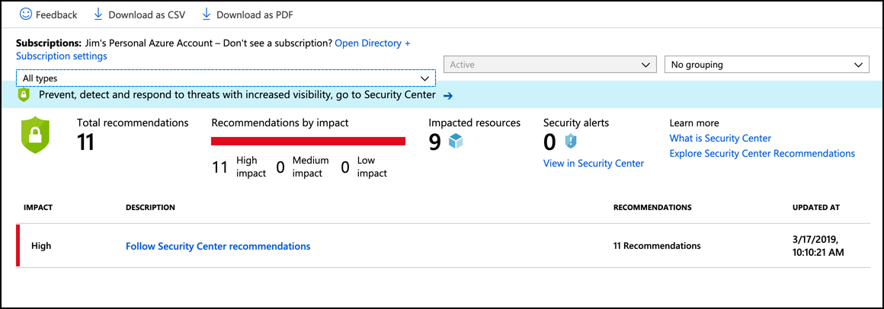
Azure Advisor
Clicking on the Security tile takes you to a view of all security recommendations.

Slide 28
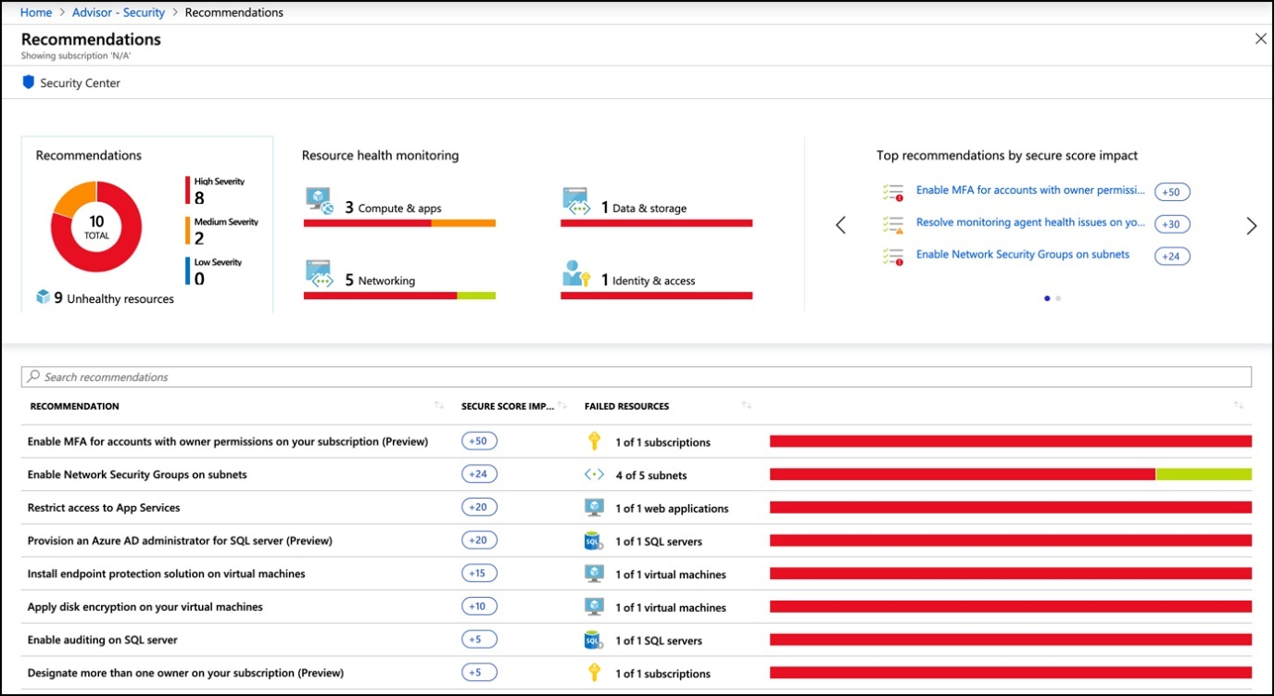
Azure Advisor
From this blade, I can open Security Center to view details on these recommendations, but I can also click on Follow Security Center Recommendations to view and take action directly from within Azure Advisor. When this is clicked, you are taken to a comprehensive list. Click on any of these recommendations for more details and to take action on the recommendation.

Slide 29
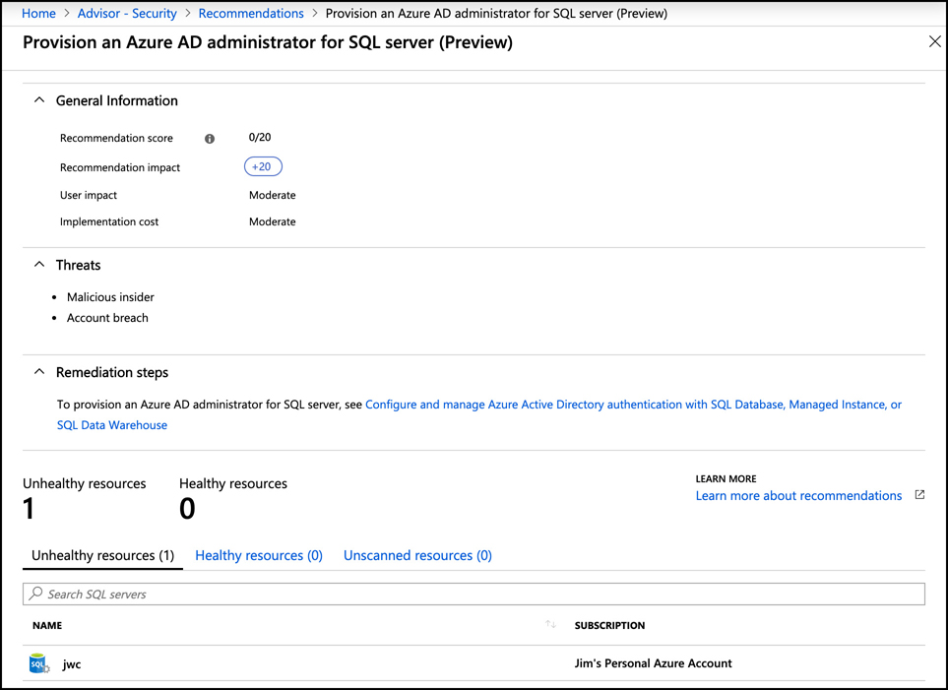
Azure Advisor
An individual recommendation is shown. You can also see the steps to take to address the recommendation, and a list of Azure resources affected by the recommendation.

